Slide 1
Controlo de pressão de uma bomba de água-TS3
Andreia silva n36920
Elias bionto n49138
Edmilson soares n

Slide 2
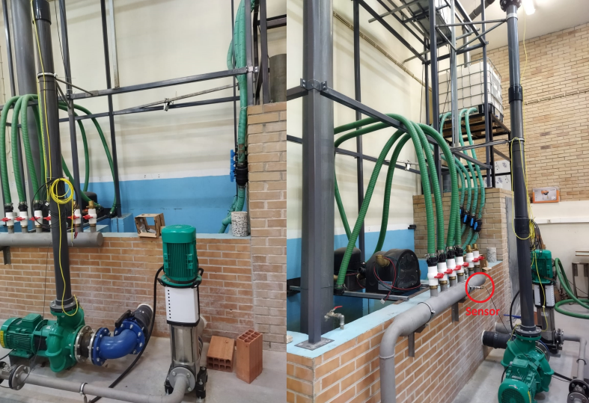
What is our challenge/problem? Why is it important?

Slide 3
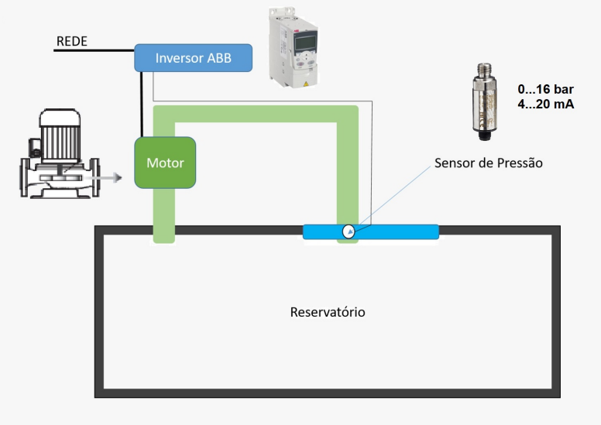
In general terms, how are these solutions implemented?

Slide 4
Regarding the information we found: Have these solutions already been tested? What problems have been identified? What are the advantages of these solutions? What are the limitations/difficulties? Are they relevant for our challenge/problem? May we start from them?
https://www.youtube.com/watch?v=f0lZpcRuWxo&ab_channel=JohnyGaldinohttps://
www.youtube.com/watch?v=ieogja97YRg&ab_channel=AplicarEscoladeEngenharia

Slide 5
What is the most suitable macro? What is the control variable? What is the set point? How can I set it?

Slide 6
What are the main parameters to adjust?
planilha

Slide 7
What connections do I have to make? How?

